Slide 1


FAKE CURRENCY DETECTION USING DEEP LEARNING
Submitted By
M.DHANALAKSHMI 19P31A1223
A.KARTHIK 19P31A1202
P.RAGHUNADH 19P31A1243
ANJALI YADAV 19P31A1259
Under the esteemed super vision of
Mrs.N.SURYAKALA.,MTECH
Department of Information Technology
Aditya College Of Engineering And Technology
Permanently affiliated to JNTUK Kakinada, Approved by AICTE,
Accredited by NAAC & NBA
Aditya nagar , ADB Road, Surampalem , Kakinada Dist,533437
2019-2023

Slide 2
Abstract
Fake currency notes are increasing day by day, in order to overcome this we proposes a very helpful and efficient system to detect the fake currency.
For detecting the fake currency note is done by counting the number of interruptions in the thread line.
For predicting the note is real or fake on the basis of number of interruptions. If the number of interruption is zero, if it is real note otherwise it is fake and also we calculate the entropy of the currency notes for the efficient detection of fake currency note.
Indian fake currency recognition is designed for identification of Indian currency notes and checks whether it is fake or original.
The project is very useful in banking system and other field also.

Slide 3
Introduction
Computers and mobile phones have become an unavoidable part of our lives. There are a lot of things which we can do with these technologies. With the rapid development of mobile phones and technologies come several services like application creation - (refers to the process of making application software for handheld and desktop devices such as mobile phones, personal computers and Personal Digital Assistants. Through the usage of apps, the user is provided with various features that will enable him to fulfill all his needs and much more.

Slide 4
Introduction
Apps should be interactive to the users, Camera/webcam services- includes use of camera services for processing various aspects of image. Fake currency Detection is a system that can be used to overcome the limitations most of the people and our institutions of higher learning face with respect to making difference between counterfeit currencies- (is imitation currency produced without the legal sanction of the state or government, usually in a deliberate attempt to imitate that currency and so as to deceive its recipient) and real currencies. The project involves making use of Digital Image Processing Domain - Digital image processing is the use of computer algorithms to perform image processing on digital images.

Slide 5
Machine Learning
• Deep learning is an artificial intelligence (AI) function that imitates the workings of the human brain in processing data and creating patterns for use in decision making.
Deep learning is a subset of machine learning in artificial intelligence that has networks capable of learning unsupervised from data that is unstructured or unlabeled.

Slide 6
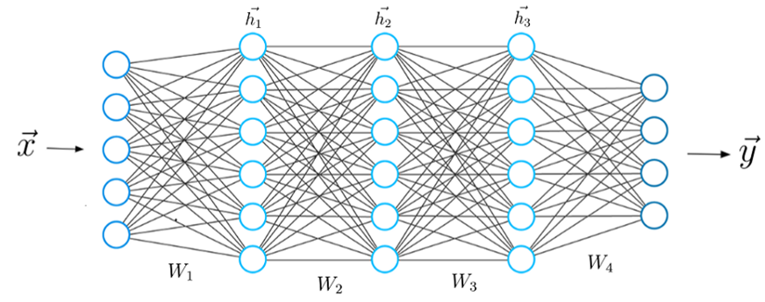
Neural Network Architecture

Slide 7
Dataset
Indian Currency Notes Classifier
This Dataset contains 195 images of 7 categories of Indian Currency Notes, this data is collected from Google images, Shutter-stock images and Data flicr respectively, you can Play with this Dataset, to recognize type of Indian Note, from the Photo, or real Time Applications.
This Dataset looks forward, as a Image Classification Data, which contains 7 Distinct types of Indian Currency Notes, the images are not reduced to any single size, they may have different proportions.

Slide 8
About Dataset
•Fake currency detection has been imported from Kaggle with total of 1000 images split into train , test folders each divided into category fake and real.
•The dataset is classified into 2 classes that is one for fake and another for real.
•The dataset can be partitioned into train and test data with 80:20 ratio.

Slide 9
CNN (Convolutional Neural Networks)
In this project we use Convolutional Neural Networks for the processing of images and getting appropriate outputs from it.
CNN or the convolutional neural network (CNN) is a class of deep learning . The CNN as a machine learning algorithm that can take in an input image, assign importance (learnable weights and biases) to various aspects/objects in the image, and be able to differentiate one from the other.

Slide 10
CNN
CNN works by extracting features from the images. Any CNN consists of the following:
  The input layer which is a grayscale image
  The Output layer which is a binary or multi-class labels
  Hidden layers consisting of convolution layers, ReLU (rectified linear unit) layers, the pooling layers, and a fully connected Neural Network

Slide 11
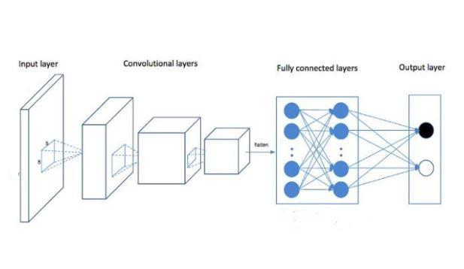
CNN Architecture

Slide 12
1.1 Purpose of the system:
To develop a system using deep learning algorithm that is conventional neural network to predict the whether the indian currency note is real or fake.
1.2 Scope of the System
Study existing image detection schemes and concern on recognition base types.
Study the usability features of the existing fake currency detection methods from the general features.
Mapping between the recognition-based image detection system methods and the usability features and extract a collection of usability features to be built in the new system prototype.

Slide 13
2. Existing System:
In Existing System takes an image acquisition that means taking an input as the image only through the scanner and in this there is no use of any digital camera to capture the image in the real time system.
In this existing system, only front part of the note is take into consideration and not the rear part.
3. Proposed System:
The proposed system contains the advantages of the existing system and eliminates the disadvantages of it.
The project centers on the design and implementation of Fake Currency Detection Application.
The scope of the project is to provide approaches and strategies, which have proved to be suitable when accessing the image of the desired currency note.

Slide 14
4. Functional Requirements:
Security
Maintainability
Reliability
Scalability
Performance
Re usability

Slide 15
5 Non-Functional Requirements:
5.1 Software Requirements:
Operating System: - Windows
IDE – Jupyter
5.2 Hardware Requirements:
Processor: -Intel i3 & above
Ram: -Minimum 4GB & above
Hard Disk: -2GB
System Type: -64 bit

Slide 16
5.3 Reliability:
This system produce a system that it has tell whether note is fake or real.
5.4 Performance:
As it makes use of model that help us to make the system high having performance output.

Slide 17
6 System Architecture:
6.1 System architecture:
Input Currency
Note
Gray scale
Train data
Fake & real
Currency note data set
CNN
Model
Output
Prediction
(Fake or Real)
Test
data

Slide 18
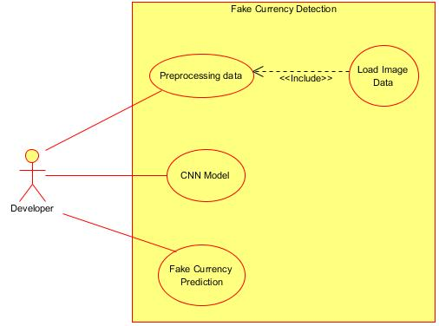
6.2 Uml diagram:
Usecase Diagram for Developer

Slide 19
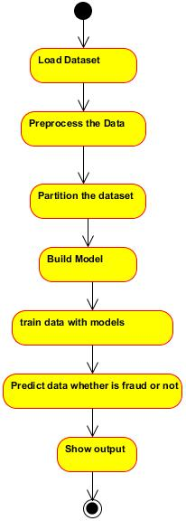
6.2 Uml diagram:
State Chart Diagram

Slide 20
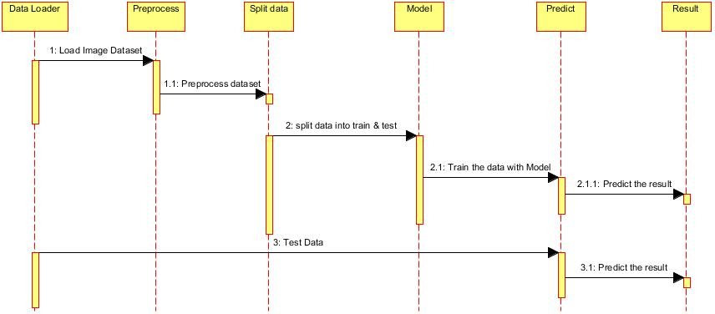
6.2 Uml diagram:
sequence diagram

Slide 21
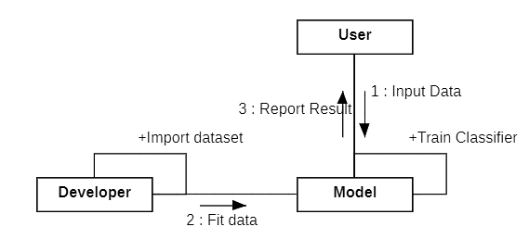
6.2 Uml diagram:
Communication diagram

Slide 22
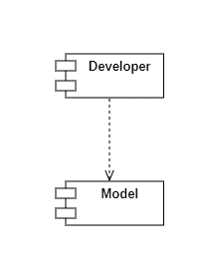
6.2 Uml diagram:
Component Diagram

Slide 23
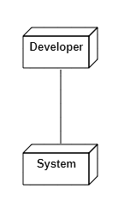
6.2 Uml diagram:
Deployment Diagram

Slide 24
Conclusion
• We commenced with a brief introduction to our system and discussed the scope and objectives of our project. During the literature survey we got an opportunity to look closely into the problem that people are facing in the current environment, we reviewed multiple research papers we selected five papers as our base research papers. We analyzed all existing architectures of our base papers and by understanding their working we have discovered some flaws in the currently existing system. We have kept all the prime features of existing systems as a primary focus with some of the additional features for our proposed system.

Slide 25
References
[1] Dr. S. V. Viraktamath, Kshama Tallur and Rohan Bhadavankar, Vidya “Review on Detection of Fake Currency using Image processing Techniques”, IEEE Xplore Part Number: CFP21K74-ART; ISBN: 978-0-7381-1327-2
[2] M s. Megha Jadhav, Dr. Yogesh kumar Sharma, Dr. G. M. Bhandari, “Currency Identification and Forged Banknote Detection using Deep Learning”, ISBN -978-1-7281-1901-4
[3] Aman Bhatia, Vansh Kedia, Anshul Shroff, Mayand Kumar, Bickey Kumar Shah and Bickey Kumar Shah, “Aman Bhatia, Vansh Kedia, Anshul Shroff, Mayand Kumar, Bickey Kumar Shah and Bickey Kumar Shah”, December 1, 2016, date of current version January 27, 2017.

Slide 26
Thankyou

